Slide 1
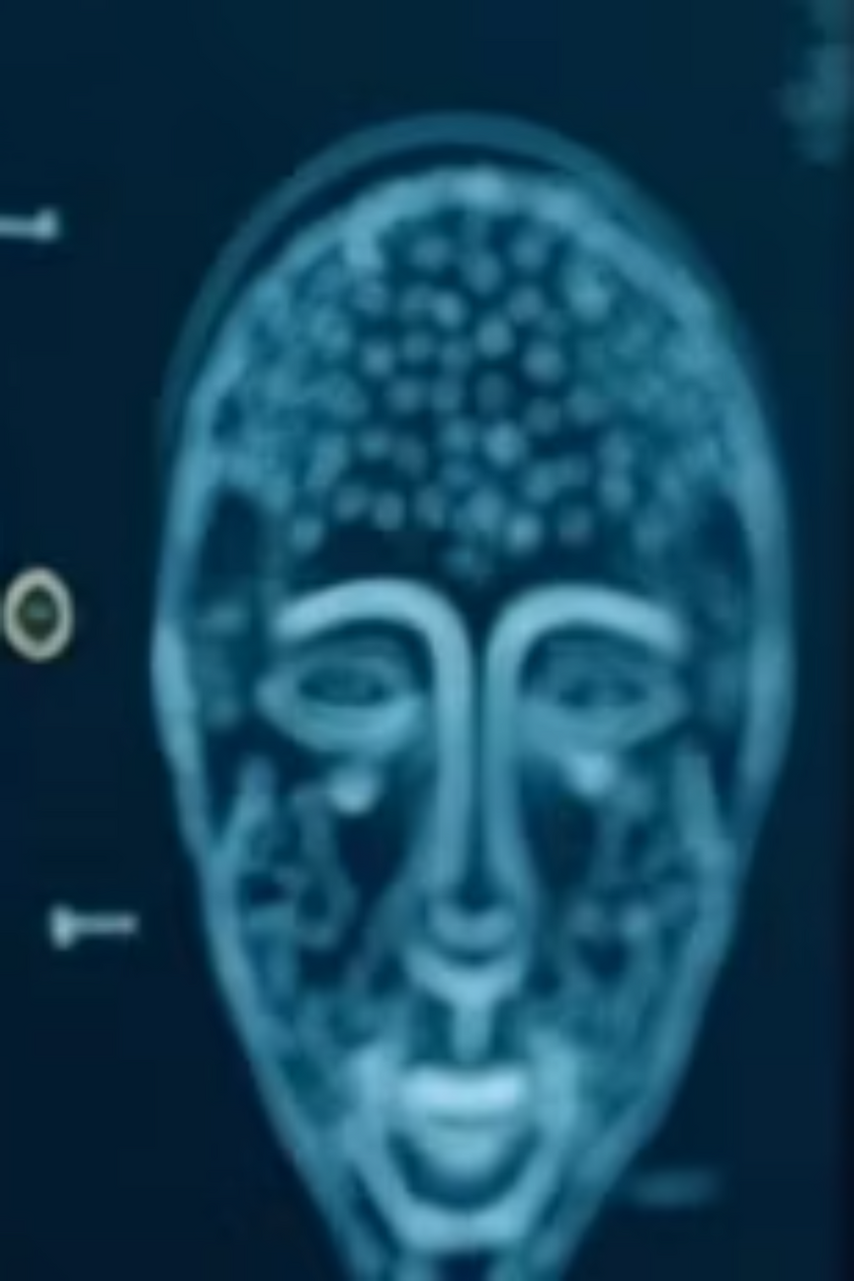
Face Recognition and Deepfake Detection
Exploring the intersection of biometric identification and synthetic media authentication in the age of AI
Face Recognition is a biometric technology that identifies or verifies a person's identity by analyzing facial features with high precision. Deepfakes are synthetic images and videos created using advanced AI techniques—such as Generative Adversarial Networks (GANs)—that realistically portray individuals saying or doing things they never actually did.
Notes:
1

Slide 2

Meet the Team
Four dedicated researchers advancing the frontier of face recognition and deepfake detection technology.
M. Sai Shreyas Reddy
CV. Bhargav Gowd
22BTRCL094
22BTRCL043
K. Harsha Vardhan
CH. Madhu Keerthi
22BTRCL075
22BTRCL038
Notes:
2

Slide 3
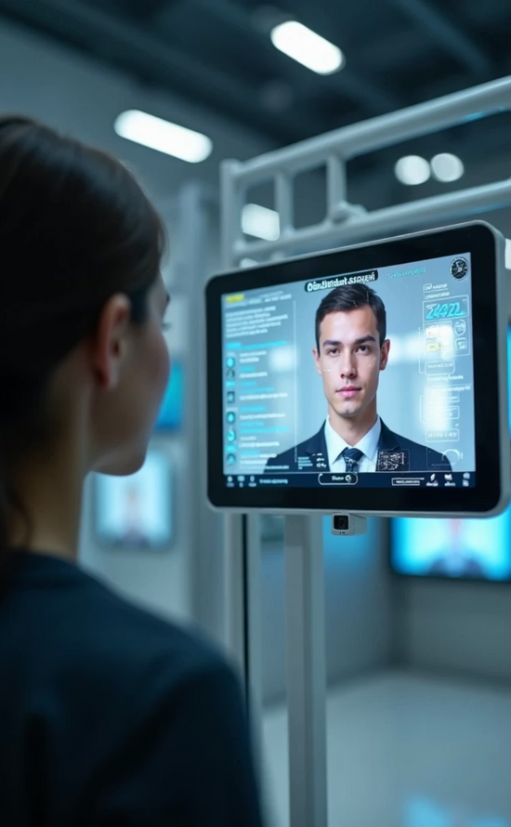
Introduction to Face Recognition
Definition and Purpose
Face recognition technology identifies or verifies an individual's identity based on their unique facial features. Modern systems can extract and compare facial landmarks with remarkable accuracy.
Historical Evolution
From geometric facial analysis in the 1960s to contemporary deep learning algorithms, the field has undergone transformative advances. Today's systems leverage neural networks trained on massive datasets.
Real-World Applications
Deployed across law enforcement for suspect identification, marketing for behavioral insights, mobile devices for authentication, and security systems for access control.
Notes:
3

Slide 4


Face Recognition Techniques
Evolution from traditional geometry-based methods to advanced deep learning approaches.
Traditional Approaches
Landmark-based geometric techniques focused on facial proportions and key reference points. Limited effectiveness due to sensitivity to lighting, head pose, and facial expressions.
Machine Learning Era
Classical machine learning algorithms such as Support Vector Machines (SVM) and k-Nearest Neighbors (k-NN) improved face recognition accuracy by leveraging learned embeddings rather than raw pixel data. These methods could classify faces effectively when combined with feature extractors like HOG or early neural network embeddings, but their performance degraded as the number of classes or variations in pose, lighting, and expression increased.
Deep Learning Revolution
The advent of Convolutional Neural Networks (CNNs) allowed face recognition systems to automatically learn hierarchical and discriminative representations directly from images. Modern CNN-based models, such as DenseNet, FaceNet, and ArcFace, achieve near-human accuracy by training on millions or billions of images. However, these models can be computationally expensive, and their confidence scores may not reflect true similarity, motivating hybrid approaches combining deep embeddings with lightweight classifiers and cosine similarity for reliable predictions.
Notes:
4

Slide 5


Model Architecture
A hybrid facial recognition pipeline combining deep feature extraction with lightweight classification for high accuracy and efficient inference.
Feature Extraction
Embedding Generation
DenseNet-121 is used to extract high-dimensional embeddings from facial crops. Its dense connections allow efficient gradient flow and capture both coarse and fine facial details, making the embeddings robust to variations in pose, expression, and occlusion.
Extracted embeddings are L2-normalized, producing a representation that is invariant to lighting and scale changes. Normalized embeddings enable reliable similarity measurement using cosine similarity, which serves as the confidence score during recognition.
Classification Layer
A Decision Tree classifier maps embeddings to identities, enabling rapid classification across multiple registered faces. Unlike traditional CNN classifiers, the tree provides lightweight periodic retraining whenever new faces are added. Cosine similarity is then used to filter predictions and compute a robust confidence score, combining the benefits of learned embeddings with similarity-based verification.
Notes:
5

Slide 6

Challenges in Face Recognition
Face recognition systems face technical and ethical challenges that limit their real-world deployment
Expression and Pose Variability
Lighting, Occlusion, and Environmental Factors
Privacy and Ethical Considerations
Facial expressions (smiles, frowns, or neutral) and slight pose changes significantly affect feature distributions. Robust embeddings, such as those extracted from DenseNet-121, can partially mitigate this, but extreme variations still challenge recognition accuracy.
Poor lighting, shadows, or overexposed regions, as well as occlusions like masks, glasses, or scarves, distort key facial features. These conditions reduce the reliability of both embeddings and classifier predictions.
Widespread facial recognition raises privacy concerns, including unauthorized surveillance, consent issues, and potential bias in identification. Data retention, anonymization, and ethical use policies are critical for responsible deployment
Notes:
6

Slide 7
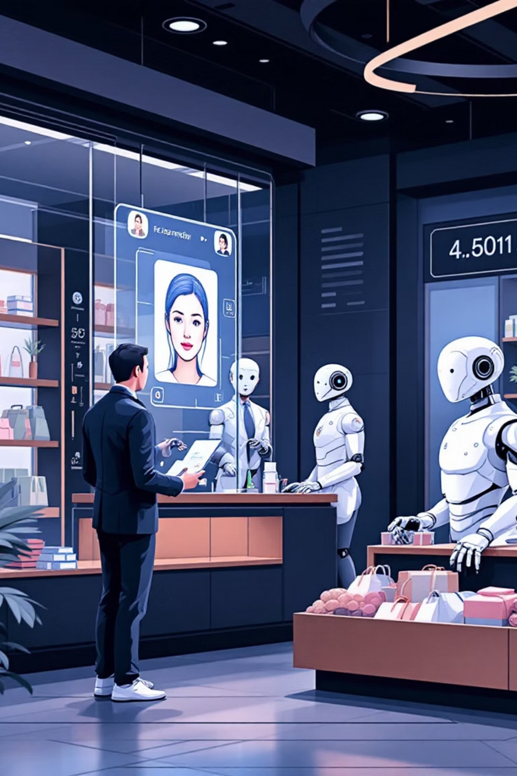






Applications of Face Recognition
Diverse use cases spanning security, interaction, and commercial domains.
Human-Robot Interaction
Security and Surveillance
Robots identify individuals to personalize responses, improve engagement, and adapt behavior based on recognized users' preferences.
Law enforcement uses facial recognition for suspect identification, border control, and real-time threat detection at high-security venues.
Customer Behavior Analysis
Retailers analyze shopper emotions and reactions to optimize store layouts, product placements, and marketing messages for enhanced sales.
Notes:
7

Slide 8

Introduction to Deepfake Technology
Understanding synthetic media creation and its implications for authenticity in the digital age.
Definition
Deepfakes are synthetic images and videos created using AI techniques—primarily Generative Adversarial Networks (GANs)—that realistically portray individuals in fabricated scenarios.
Dual-Use Technology
Legitimate applications in entertainment, visual effects, and artistic expression contrast sharply with threats of political misinformation, fraud, and identity theft.
Accessibility Surge
Democratization of deepfake tools enables non-technical users to create convincing fake media, accelerating both beneficial and harmful applications at scale.
Notes:
8

Slide 9
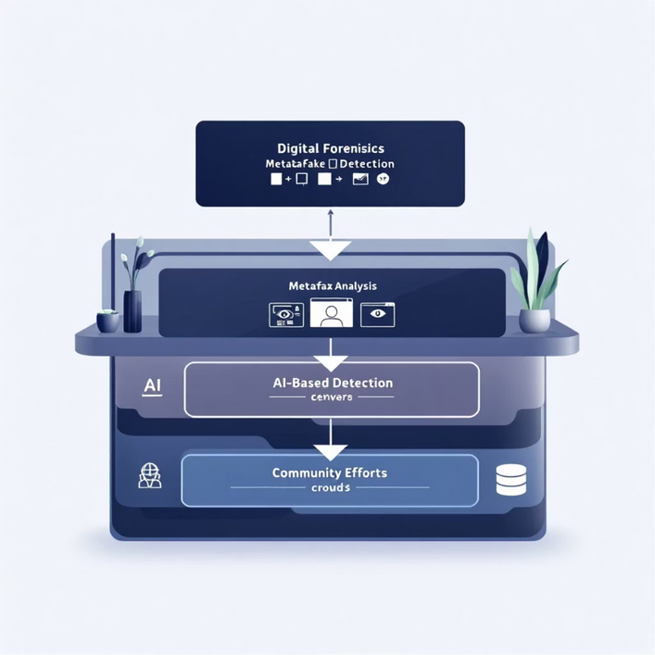
Deepfake Detection Techniques
Multi-layered approaches combining forensics, AI, and community intelligence.
1
Digital Forensics
Traditional approaches analyze metadata, pixel-level inconsistencies, and image integrity markers to detect manipulations and authenticate media provenance.
2
AI-Based Detection
Advanced deep learning systems identify subtle artifacts—lip-sync mismatches, unnatural eye movements, lighting inconsistencies—that human observers miss.
3
Community Efforts
Crowdsourced databases, public awareness campaigns, and collaborative initiatives build collective resilience against deepfake misinformation.
Notes:
9

Slide 10
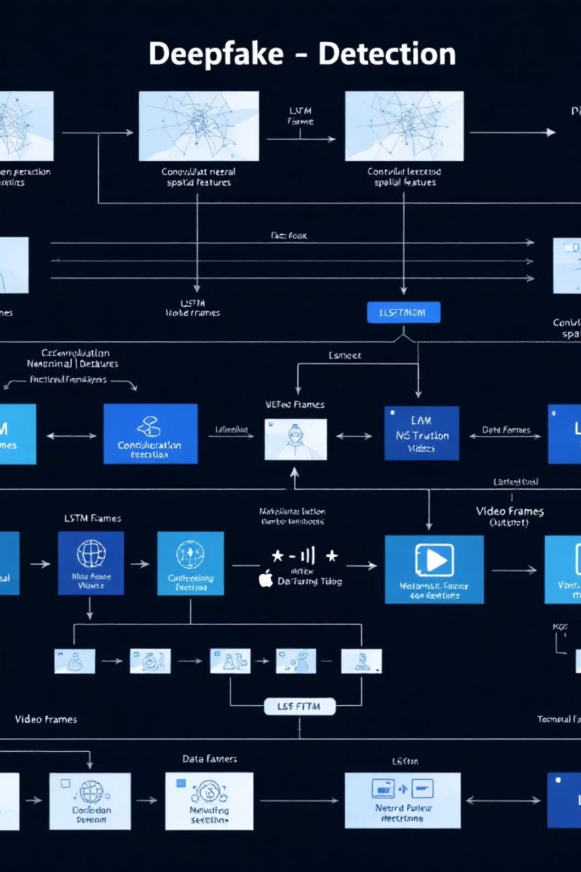

Deepfake Detection Model Architecture
Leveraging temporal analysis to expose synthetic video inconsistencies.
CNN Pipeline
Extracts spatial features from individual video frames, learning facial appearance patterns and potential anomalies within static images.
LSTM Sequence
Analyzes temporal patterns across consecutive frames, detecting inconsistencies in motion, lip-sync alignment, and pixel-level continuity that betray synthetic origin.
Why This Architecture?
DenseNet Features: Dense skip connections prevent vanishing gradients and extract robust embeddings resistant to subtle deepfake artifacts.
CNN-LSTM Synergy: Spatial CNN features combined with temporal LSTM analysis detects lip-sync mismatches, texture discontinuities, and temporal noise characteristic of synthetic media.
Notes:
10

Slide 11



Ethical Implications of Deep Fakes
Manipulation of Information
Impact on Personal Identity
Legislation and Regulatory Responses
Deep fakes can mislead the public, potentially influencing elections or causing societal unrest.
Realistic impersonations can lead to severe personal and financial ramifications for victims.
Governments are increasingly called to enact laws to address the misuse of deep fakes.
Notes:
11

Slide 12

The Urgent Need for Deep Fake Detection
As artificial intelligence becomes increasingly sophisticated, detecting manipulated media is essential to maintaining trust and security across digital ecosystems. Deep fake detection protects multiple critical domains.
Prevent Fraud and Cybercrime
Stop malicious actors from exploiting AI for identity theft, financial fraud, and coordinated disinformation campaigns.
Protect Individual Privacy
Safeguard citizens from non-consensual creation and distribution of false media.
Ensure Digital Media Trust
Maintain public confidence in legitimate video, audio, and photographic evidence.
Safeguard Democratic Processes
Defend elections, law enforcement integrity, and societal stability from manipulation.
Notes:
12

Slide 13

Real-World Applications of Deep Fake Detection
Detection technologies are becoming critical across sectors. Each industry requires tailored approaches to identify and mitigate manipulated content threats.
Digital Platforms & Media
Security & Justice
Social media flagging manipulated videos and images
Cybersecurity preventing identity fraud and account takeovers
Journalism ensuring content authenticity before publication
Law enforcement detecting fake confessions and fabricated evidence
Entertainment responsible use of AI in films and games
Legal systems protecting against fraudulent documentation
Notes:
13

Slide 14

Future Perspectives on Face Recognition and Deep Fakes
The landscape of facial recognition and deep fake technology continues to evolve rapidly. Success requires balancing technological advancement with robust ethical frameworks and comprehensive regulatory oversight.
Emerging Technologies
Integration of Ethical AI
Innovations in machine learning and neural networks will dramatically enhance detection accuracy, enabling real-time identification of manipulated media across platforms.
Responsible development prioritizing ethical considerations from inception ensures AI systems respect privacy, maintain transparency, and protect vulnerable populations.
Comprehensive Policy Frameworks
Balancing technological advancement with privacy rights through clear, enforceable policies and international cooperation is essential for sustainable progress.
Notes:
14

Slide 15



Moving Forward: Key Takeaways
Collaborative Innovation
Foundational Challenge
Ongoing Research
Technology leaders, policymakers, and civil society must work together to develop responsible detection systems while preventing misuse of deep fake technology.
Face recognition technology represents one of the most powerful and problematic tools in modern AI—deep fakes amplify these risks exponentially.
Continuous advancement in detection methods and ethical frameworks is essential to enhance public safety, preserve trust, and protect democratic institutions.
Notes:
15

Slide 16
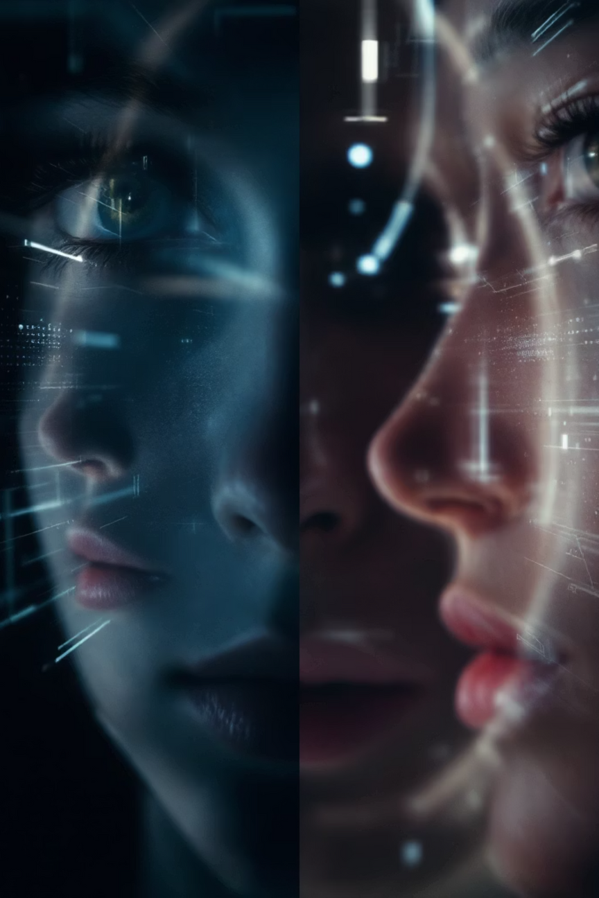
Thank You
Advancing the conversation on ethical AI and digital media integrity
Notes:
16

